Slide 1

Predicting HOTEL Pricing
Afnan Alshehri

Slide 2
INTRODUCTION
Modling
Intro
Data visualization
Predicting HOTEL Pricing

Slide 3
INTRODUCTION
This linear regression project aims to predict the prices of the rooms in future based on the most important characteristics that affect its value in the hotel.

Slide 4
Problem statement
What is the effect of features on rooms prices?
OBJECTIVE
Predict rooms prices Based one specific rooms features

Slide 5
DATA SET
TOOLS
The data to be tested in this project are scraped from https://www.agoda.com/ar-ae/
Before cleaning: 2247 rows and (6) columns.
After cleaning :2247 rows and (4)
Pandas
Numpy
Sklearn
Seaborn
Matplotib

Slide 6
Data cleaning
Drop duplicate
Remove and handling Null Values
Drop unnecessary columns that
doesn’t give me any values type
Convert values type

Slide 7
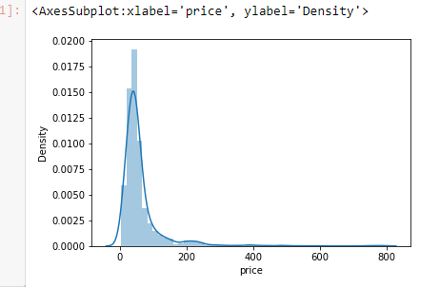
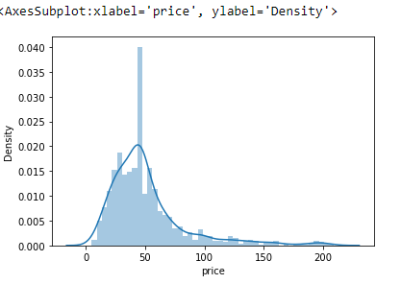
Outliers

Slide 8
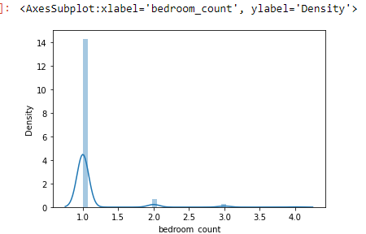
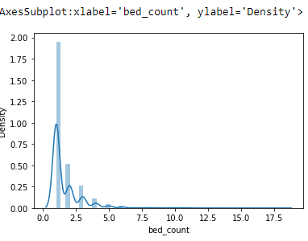
Outliers

Slide 9
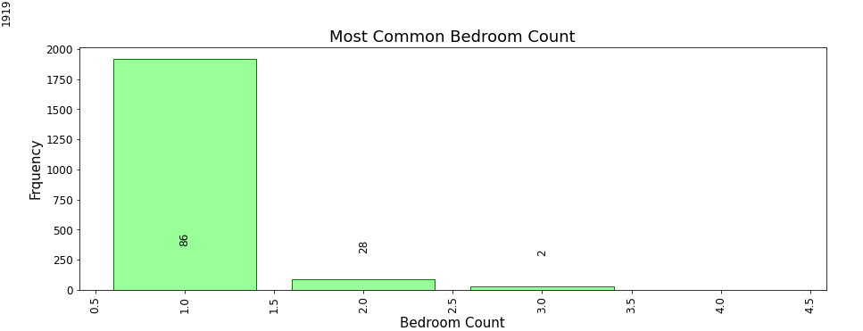
Common Bedroom Count

Slide 10
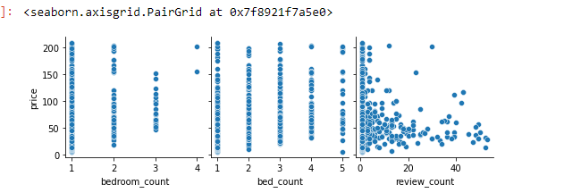
Linear Regression

Slide 11
REGRESSION MODELS The best model is Decision Tree then Polynomial.
Cost Function predict | Cost Function training | Model Type
0.13 | 0.18 | Polynomial
0.15 | 0.16 | Ridge
0.17 | 0.18 | Lasso
0.16 | 0.21 | Decision Tree

Slide 12
The best model is Decision Tree then Polynomial.

Slide 13
THANKS!
DOES ANYONE HAVE ANY QUESTIONS?

